Slide 1
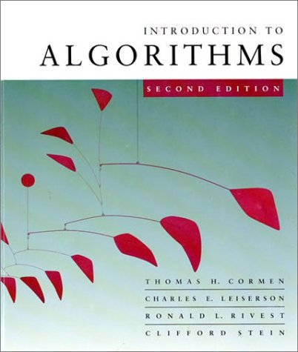
Introduction to Algorithms
6.046
Lecture 6
Prof. Shafi Goldwasser

Slide 2
How fast can we sort?
All the sorting algorithms we have seen so far are comparison sorts: only use comparisons to determine the relative order of elements.
E.g., insertion sort, merge sort, quicksort, heapsort.
The best worst-case running time that we’ve seen for comparison sorting is O(n lg n) .
Q:Is O(n lg n) the best we can do?
A: Yes, as long as we use comparison sorts
TODAY: Prove any comparison sort has
Ω(n long) worst case running time

Slide 3
The Time Complexity of a Problem
The minimum time needed by an algorithm to solve it.
Upper Bound:
Problem P is solvable in time T_{upper}(n)
    if there is an algorithm A which
      outputs the correct answer
      in this much time
∃ A, ∀ I, A(I)=P(I) and Time(A,I) ≤ T_{upper}(|I|)
Eg: Sorting computable in T_{upper}(n) = O(n²) time.

Slide 4
The Time Complexity of a Problem
The minimum time needed by an algorithm to solve it.
Lower Bound:
Time T_{lower}(n) is a lower bound for problem
  if no algorithm solve the problem faster.
There may be algorithms that give the correct answer
or run quickly on some inputs instance.

Slide 5
The Time Complexity of a Problem
The minimum time needed by an algorithm to solve it.
Lower Bound:
Time T_{upper}(n) is a lower bound for problem P
  if no algorithm solve the problem faster.
But for every algorithm, there is at least one instance I for which either the algorithm gives the wrong answer or it runs in too much time.
∀ A, ∃ I, A(I) = P(I) or Time(A,I) ≥ T_{lower}(|I|)
Eg: No algorithm can sort N values in T_{lower} = sqrt(N) time.

Slide 6
The Time Complexity of a Problem
The minimum time needed by an algorithm to solve it.
Upper Bound:
∃ A, ∀ I, A(I)=P(I) and Time(A,I) ≤ T_{upper}(|I|)
Lower Bound:
∀ A, ∃ I, A(I) = P(I) or Time(A,I) ≥ T_{lower}(|I|)
“There is” and “there isn’t a faster algorithm”
are almost negations of each other.

Slide 7
Prover-Adversary Game
Upper Bound:
∃ A, ∀ I, A(I)=P(I) and Time(A,I) ≤ T_{upper}(|I|)
I have an algorithm A that I claim works and is fast.
Oh yeah, I have an input I for which it does not.
I win if A on input I gives
  the correct output
  in the allotted time.
What we have been doing all along.

Slide 8
Prover-Adversary Game
Lower Bound:
∀ A, ∃ I, [ A(I) = P(I) or Time(A,I) ≥ T_{lower}(|I|)]
I have an algorithm A that I claim works and is fast.
Oh yeah, I have an input I for which it does not .
I win if A on input I gives
  the wrong output or
  runs slow.
Proof by contradiction.

Slide 9
Prover-Adversary Game
Lower Bound:
∀ A, ∃ I, [ A(I) = P(I) or Time(A,I) ≥ T_{lower}(|I|)]
I have an algorithm A that I claim works and is fast.
Lower bounds are very hard to prove, because I must consider every algorithm
no matter how strange.

Slide 10
Today:
Prove a Lower Bound for any comparison based algorithm for the Sorting Problem
How?
Decision trees help us.

Slide 11
Decision-tree example
Sort ⟨a₁, a₂, …, a_{n}⟩
1:2
2:3
1:3
123
1:3
213
2:3
132
312
231
321
Each internal node is labeled i:j for i, j ∈ {1, 2,…, n}.
The left subtree shows subsequent comparisons if a_{i} ≤ a_{j}.
The right subtree shows subsequent comparisons if a_{i} ≥ a_{j}.

Slide 12
Decision-tree example
Sort ⟨a₁, a₂, a₃⟩ = ⟨ 9, 4, 6 ⟩:
1:2
9 ≥ 4
2:3
1:3
123
1:3
213
2:3
132
312
231
321
Each internal node is labeled i:j for i, j ∈ {1, 2,…, n}.
The left subtree shows subsequent comparisons if a_{i} ≤ a_{j}.
The right subtree shows subsequent comparisons if a_{i} ≥ a_{j}.

Slide 13
Decision-tree example
Sort ⟨a₁, a₂, a₃⟩ = ⟨ 9, 4, 6 ⟩:
1:2
2:3
1:3
9 ≥ 6
123
1:3
213
2:3
132
312
231
321
Each internal node is labeled i:j for i, j ∈ {1, 2,…, n}.
The left subtree shows subsequent comparisons if a_{i} ≤ a_{j}.
The right subtree shows subsequent comparisons if a_{i} ≥ a_{j}.

Slide 14
Decision-tree example
Sort ⟨a₁, a₂, a₃⟩ = ⟨ 9, 4, 6 ⟩:
1:2
2:3
1:3
123
1:3
213
2:3
4 ≤ 6
132
312
231
321
Each internal node is labeled i:j for i, j ∈ {1, 2,…, n}.
The left subtree shows subsequent comparisons if a_{i} ≤ a_{j}.
The right subtree shows subsequent comparisons if a_{i} ≥ a_{j}.

Slide 15
Decision-tree example
Sort ⟨a₁, a₂, a₃⟩ = ⟨ 9, 4, 6 ⟩:
1:2
2:3
1:3
123
1:3
213
2:3
132
312
231
321
4 ≤ 6 ≤ 9
Each leaf contains a permutation ⟨π(1), π(2),…, π(n)⟩ to indicate that the ordering a_{π(1)} ≤ a_{π(2)} ≤ ☹ ≤ a_{π(n)} has been established.

Slide 16
Decision-tree model
A decision tree can model the execution of any comparison sort:
One tree for each input size n.
View the algorithm as splitting whenever it compares two elements.
The tree contains the comparisons along all possible instruction traces.
The running time of the algorithm = the length of the path taken.
Worst-case running time = height of tree.

Slide 17
Any comparison sort
Can be turned into a Decision tree
class InsertionSortAlgorithm {
for (int i = 1; i < a.length; i++) {
int j = i;
while ((j > 0) && (a[j-1] > a[i])) {
a[j] = a[j-1];
j--; }
a[j] = B; }}
1:2
2:3
1:3
123
1:3
213
2:3
132
312
231
321

Slide 18
Lower bound for decision-tree sorting
Theorem. Any decision tree that can sort n elements must have height Ω(n lg n) .
Proof. The tree must contain ≥ n! leaves, since there are n! possible permutations. A height-h binary tree has ≤ 2^{h} leaves. Thus, n! ≤ 2^{h} .
∴ h ≥ lg(n!) (lg is mono. increasing)
≥ lg ((n/e)^{n}) (Stirling’s formula)
= n lg n – n lg e
= Ω(n lg n) .

Slide 19
Lower bound for comparison sorting
Corollary. Heapsort and merge sort are asymptotically optimal comparison sorting algorithms.

Slide 20
Sorting
Lower Bound
Is there a faster algorithm?
If different model of computation?
class InsertionSortAlgorithm {
for (int i = 1; i < a.length; i++) {
int j = i;
while ((j > 0) && (a[j-1] > a[i])) {
a[j] = a[j-1];
j--; }
a[j] = B; }}

Slide 21
Sorting in linear time
Counting sort: No comparisons between elements.
Input: A[1 . . n], where A[ j]∈{1, 2, …, k} .
Output: B[1 . . n], sorted.
Auxiliary storage: C[1 . . k] .

Slide 22
Counting sort
for i ← 1 to k
  do C[i] ← 0
for j ← 1 to n
  do C[A[ j]] ← C[A[ j]] + 1 ⊳ C[i] = |{key = i}|
for i ← 2 to k
  do C[i] ← C[i] + C[i–1] ⊳ C[i] = |{key ≤ i}|
for j ← n downto 1
  do B[C[A[ j]]] ← A[ j]
  C[A[ j]] ← C[A[ j]] – 1

Slide 23
Counting-sort example
1
2
3
4
5
1
2
3
4
A:
4
1
3
4
3
C:
B:

Slide 24
Loop 1
1
2
3
4
5
1
2
3
4
A:
4
1
3
4
3
C:
0
0
0
0
B:
for i ← 1 to k
  do C[i] ← 0

Slide 25
Loop 2
1
2
3
4
5
1
2
3
4
A:
4
1
3
4
3
C:
0
0
0
1
B:
for j ← 1 to n
  do C[A[ j]] ← C[A[ j]] + 1 ⊳ C[i] = |{key = i}|

Slide 26
Loop 2
1
2
3
4
5
1
2
3
4
A:
4
1
3
4
3
C:
1
0
0
1
B:
for j ← 1 to n
  do C[A[ j]] ← C[A[ j]] + 1 ⊳ C[i] = |{key = i}|

Slide 27
Loop 2
1
2
3
4
5
1
2
3
4
A:
4
1
3
4
3
C:
1
0
1
1
B:
for j ← 1 to n
  do C[A[ j]] ← C[A[ j]] + 1 ⊳ C[i] = |{key = i}|

Slide 28
Loop 2
1
2
3
4
5
1
2
3
4
A:
4
1
3
4
3
C:
1
0
1
2
B:
for j ← 1 to n
  do C[A[ j]] ← C[A[ j]] + 1 ⊳ C[i] = |{key = i}|

Slide 29
Loop 2
1
2
3
4
5
1
2
3
4
A:
4
1
3
4
3
C:
1
0
2
2
B:
for j ← 1 to n
  do C[A[ j]] ← C[A[ j]] + 1 ⊳ C[i] = |{key = i}|

Slide 30
Loop 3
1
2
3
4
5
1
2
3
4
A:
4
1
3
4
3
C:
1
0
2
2
B:
C':
1
1
2
2
for i ← 2 to k
  do C[i] ← C[i] + C[i–1] ⊳ C[i] = |{key ≤ i}|

Slide 31
Loop 3
1
2
3
4
5
1
2
3
4
A:
4
1
3
4
3
C:
1
0
2
2
B:
C':
1
1
3
2
for i ← 2 to k
  do C[i] ← C[i] + C[i–1] ⊳ C[i] = |{key ≤ i}|

Slide 32
Loop 3
1
2
3
4
5
1
2
3
4
A:
4
1
3
4
3
C:
1
0
2
2
B:
C':
1
1
3
5
for i ← 2 to k
  do C[i] ← C[i] + C[i–1] ⊳ C[i] = |{key ≤ i}|

Slide 33
Loop 4
1
2
3
4
5
1
2
3
4
A:
4
1
3
4
3
C:
1
1
3
5
B:
3
C':
1
1
2
5
for j ← n downto 1
  do B[C[A[ j]]] ← A[ j]
  C[A[ j]] ← C[A[ j]] – 1

Slide 34
Loop 4
1
2
3
4
5
1
2
3
4
A:
4
1
3
4
3
C:
1
1
2
5
B:
3
4
C':
1
1
2
4
for j ← n downto 1
  do B[C[A[ j]]] ← A[ j]
  C[A[ j]] ← C[A[ j]] – 1

Slide 35
Loop 4
1
2
3
4
5
1
2
3
4
A:
4
1
3
4
3
C:
1
1
2
4
B:
3
3
4
C':
1
1
1
4
for j ← n downto 1
  do B[C[A[ j]]] ← A[ j]
  C[A[ j]] ← C[A[ j]] – 1

Slide 36
Loop 4
1
2
3
4
5
1
2
3
4
A:
4
1
3
4
3
C:
1
1
1
4
B:
1
3
3
4
C':
0
1
1
4
for j ← n downto 1
  do B[C[A[ j]]] ← A[ j]
  C[A[ j]] ← C[A[ j]] – 1

Slide 37
Loop 4
1
2
3
4
5
1
2
3
4
A:
4
1
3
4
3
C:
0
1
1
4
B:
1
3
3
4
4
C':
0
1
1
3
for j ← n downto 1
  do B[C[A[ j]]] ← A[ j]
  C[A[ j]] ← C[A[ j]] – 1

Slide 38
Analysis
for i ← 1 to k
  do C[i] ← 0
Θ(k)
for j ← 1 to n
  do C[A[ j]] ← C[A[ j]] + 1
Θ(n)
for i ← 2 to k
  do C[i] ← C[i] + C[i–1]
Θ(k)
for j ← n downto 1
  do B[C[A[ j]]] ← A[ j]
  C[A[ j]] ← C[A[ j]] – 1
Θ(n)
Θ(n + k)

Slide 39
Running time
If k = O(n), then counting sort takes Θ(n) time.
But, sorting takes Ω(n lg n) time!
Where’s the fallacy?
Answer:
Comparison sorting takes Ω(n lg n) time.
Counting sort is not a comparison sort.
In fact, not a single comparison between elements occurs!

Slide 40
Stable sorting
Counting sort is a stable sort: it preserves the input order among equal elements.
A:
4
1
3
4
3
B:
1
3
3
4
4
Exercise: What other sorts have this property?

Slide 41
Radix sort
Origin: Herman Hollerith’s card-sorting machine for the 1890 U.S. Census. (See Appendix .)
Digit-by-digit sort.
Hollerith’s original (bad) idea: sort on most-significant digit first.
Good idea: Sort on least-significant digit first with auxiliary stable sort.

Slide 42
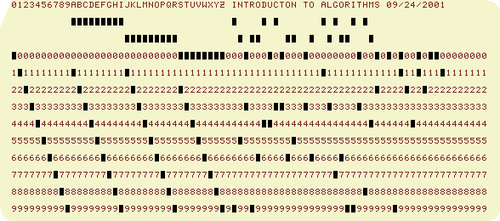
“Modern” IBM card
One character per column.
Produced by the WWW Virtual Punch-Card Server.
So, that’s why text windows have 80 columns!

Slide 43
Operation of radix sort
3 2 9
7 2 0
7 2 0
3 2 9
4 5 7
3 5 5
3 2 9
3 5 5
6 5 7
4 3 6
4 3 6
4 3 6
8 3 9
4 5 7
8 3 9
4 5 7
4 3 6
6 5 7
3 5 5
6 5 7
7 2 0
3 2 9
4 5 7
7 2 0
3 5 5
8 3 9
6 5 7
8 3 9

Slide 44
Correctness of radix sort
Induction on digit position
Assume that the numbers are sorted by their low-order t – 1 digits.
7 2 0
3 2 9
3 2 9
3 5 5
4 3 6
4 3 6
8 3 9
4 5 7
Sort on digit t
3 5 5
6 5 7
4 5 7
7 2 0
6 5 7
8 3 9

Slide 45
Correctness of radix sort
Induction on digit position
Assume that the numbers are sorted by their low-order t – 1 digits.
7 2 0
3 2 9
3 2 9
3 5 5
4 3 6
4 3 6
8 3 9
4 5 7
  Two numbers that differ in digit t are correctly sorted.
Sort on digit t
3 5 5
6 5 7
4 5 7
7 2 0
6 5 7
8 3 9

Slide 46
Correctness of radix sort
Induction on digit position
Assume that the numbers are sorted by their low-order t – 1 digits.
7 2 0
3 2 9
3 2 9
3 5 5
4 3 6
4 3 6
8 3 9
4 5 7
Sort on digit t
  Two numbers that differ in digit t are correctly sorted.
3 5 5
6 5 7
4 5 7
7 2 0
  Two numbers equal in digit t are put in the same order as the input ⇒ correct order.
6 5 7
8 3 9

Slide 47
Analysis of radix sort
Assume counting sort is the auxiliary stable sort.
Sort n computer words of b bits each.
Each word can be viewed as having b/r base-2^{r} digits.
8
8
8
8
Example: 32-bit word
  r = 8 ⇒ b/r = 4 passes of counting sort on base-2⁸ digits; or r = 16 ⇒ b/r = 2 passes of counting sort on base-2¹⁶ digits.
How many passes should we make?

Slide 48
Analysis (continued)
Recall: Counting sort takes Θ(n + k) time to sort n numbers in the range from 0 to k – 1.
If each b-bit word is broken into r-bit pieces, each pass of counting sort takes Θ(n + 2^{r}) time. Since there are b/r passes, we have
.
Choose r to minimize T(n, b):
Increasing r means fewer passes, but as r > lg n, the time grows exponentially.
>

Slide 49

Choosing r
Minimize T(n, b) by differentiating and setting to 0.
>
Or, just observe that we don’t want 2^{r} > n, and there’s no harm asymptotically in choosing r as large as possible subject to this constraint.
Choosing r = lg n implies T(n, b) = Θ(b n/lg n) .
For numbers in the range from 0 to n ^{d} – 1, we have b = d lg n ⇒ radix sort runs in Θ(d n) time.

Slide 50
Conclusions
In practice, radix sort is fast for large inputs, as well as simple to code and maintain.
Example (32-bit numbers):
At most 3 passes when sorting ≥ 2000 numbers.
Merge sort and quicksort do at least ⎡lg 2000⎤ = 11 passes.
Downside: Can’t sort in place using counting sort. Also, Unlike quicksort, radix sort displays little locality of reference, and thus a well-tuned quicksort fares better sometimes on modern processors, with steep memory hierarchies.

Slide 51
Appendix: Punched-card technology
Herman Hollerith (1860-1929)
Punched cards
Hollerith’s tabulating system
Operation of the sorter
Origin of radix sort
“Modern” IBM card
Web resources on punched-card technology
Return to last slide viewed.

Slide 52
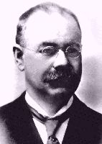
Herman Hollerith
(1860-1929)
The 1880 U.S. Census took almost
10 years to process.
While a lecturer at MIT, Hollerith
prototyped punched-card technology.
His machines, including a “card sorter,” allowed the 1890 census total to be reported in 6 weeks.
He founded the Tabulating Machine Company in 1911, which merged with other companies in 1924 to form International Business Machines.

Slide 53
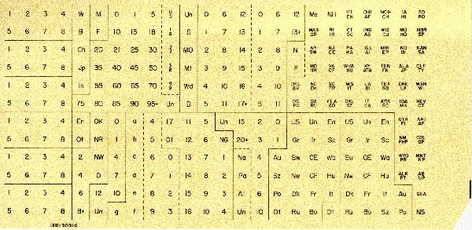
Punched cards
Punched card = data record.
Hole = value.
Algorithm = machine + human operator.
Replica of punch card from the 1900 U.S. census. [Howells 2000]

Slide 54
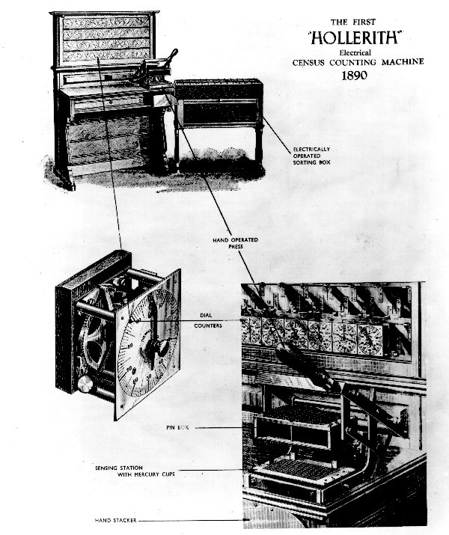
Hollerith’s tabulating system
Figure from [Howells 2000].
Pantograph card punch
Hand-press reader
Dial counters
Sorting box

Slide 55
Origin of radix sort
Hollerith’s original 1889 patent alludes to a most-significant-digit-first radix sort:
  “The most complicated combinations can readily be counted with comparatively few counters or relays by first assorting the cards according to the first items entering into the combinations, then reassorting each group according to the second item entering into the combination, and so on, and finally counting on a few counters the last item of the combination for each group of cards.”
Least-significant-digit-first radix sort seems to be a folk invention originated by machine operators.

Slide 56
Web resources on punched-card technology
Doug Jones’s punched card index
Biography of Herman Hollerith
The 1890 U.S. Census
Early history of IBM
Pictures of Hollerith’s inventions
Hollerith’s patent application (borrowed from Gordon Bell’s CyberMuseum)
Impact of punched cards on U.S. history

Slide 57
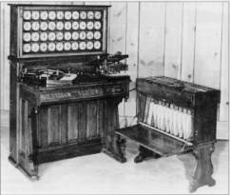
Operation of the sorter
An operator inserts a card into the press.
Pins on the press reach through the punched holes to make electrical contact with mercury-filled cups beneath the card.
Whenever a particular digit value is punched, the lid of the corresponding sorting bin lifts.
The operator deposits the card into the bin and closes the lid.
Hollerith Tabulator, Pantograph, Press, and Sorter
When all cards have been processed, the front panel is opened, and the cards are collected in order, yielding one pass of a stable sort.

